Slide 1
Profile
August 2023
Addis Ababa, Ethiopia

Slide 2
WHO WE ARE
Ethiopian Civil Society Organization
Established in 2011
Vision
Mission
Core Organizational Characteristics
To see a community of hope, humane, and social justice.
Promote hope, humanity, and social justice for every human, life in all its fullness
Human
Excellency
Optimist

Slide 3
STRATEGIC GOALS
Humanitarian Strategic Goal:
Contributes to humanitarian and emergency operations for saving lives through comprehensive engagement in emergency relief support
Development Strategic Goal:
Contributes to broader development operations through integrated livelihood, WASH, Peace Building, Women and child care, reintegration, PSS etc and contribution to basic human development

Slide 4
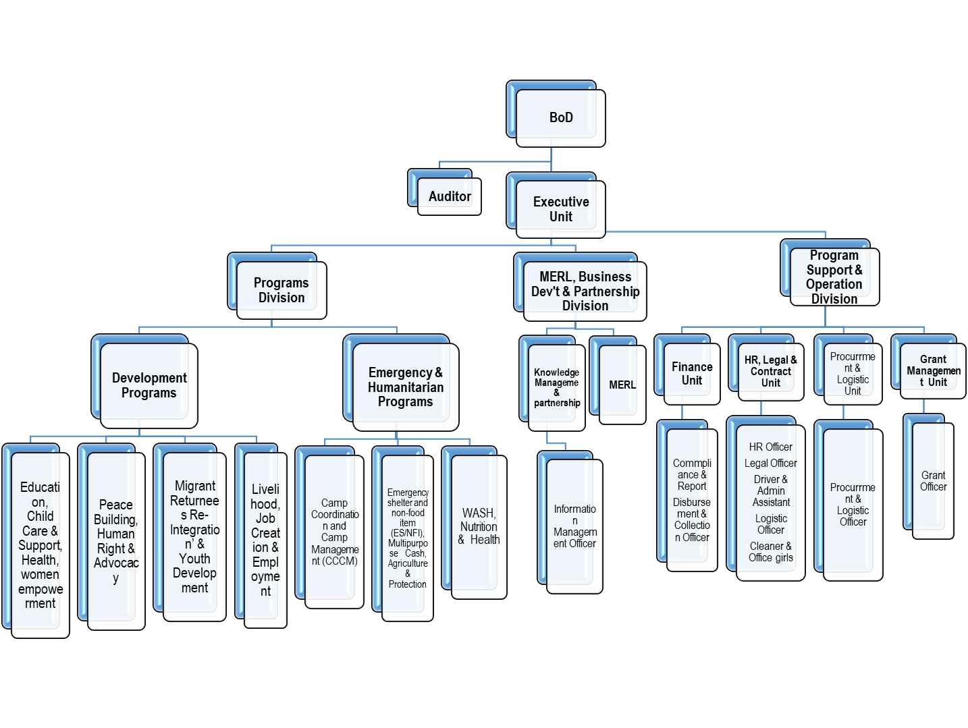
ORGANIZATIONAL STRUCTURE

Slide 5
What we do
Development Interventions
Child protection and support
Reintegration of migrant returnees
Peace building and conflict management
Non-communicable Health
Education
Livelihoods and Job creation
Rehabilitation & Reintegration Destitute
Humanitarian Interventions
Camp Coordination and Camp Management (CCCM)
Core ESNFI and Cash
Water sanitation and hygiene (WASH)
Protection
Education in emergencies (EiE)
Agriculture and Livelihood

Slide 6
WHERE WE WORK – GEOGRAPHIC AREAS
Addis Ababa city administration
Dire Dawa city administration
Amhara National Regional State
Harari National Regional State
Oromia National Regional State
Somali National Regional State
Benishangul Gumze Regional State
Tigray regional state
Afar Regional State

Slide 7
WHO WE WORK WITH
The community
Universities
Non-governmental organizations
Governmental organizations
Private organizations

Slide 8
Donors Whom we work with
Civil Society Support Program I and II (CSSP)
Afro Ethiopia Integrated Development (AEID)
Action for Social Development and Environmental Protection Organization (ASDEPO)
Ethiopian AID UK
Volunteer Over Sea (VSO)
Greet run Ethiopia
Facilitator for Change (FC)
Ministry of Women and Social Affairs (MoWSA)
UK Home Affairs
Ethiopian Emergency Fund (EHF)
International Organization of Migration (IOM)
PACT
Save the Children Ethiopia
International Republican Institute (IRI)
OTI Dexis
Global Fund
Development Expertise ( DEC)
IRARA
Family Health International 360 (Fhi360)
Luminous Fund

Slide 9
Ongoing programs
Second Chance Education Program funded by Luminous Fund
Girls Education Project funded by Malala Fund
Global reintegration program funded by IRARA
Camp coordination and camp management (CCCM) at Sekota Funded by EHF/DEC
Camp coordination and camp management (CCCM) at Borena funded by IOM-RRF
Camp coordination and camp management (CCCM) at Benishangul Gumuz funded by EHF/ASDEPO
Innovative and collaborative integrated livelihood development support for migrant returnees and their families in Aweday and Kombolcha funded by IOM

Slide 10
Ongoing programs….Cont
Ten4All (T4A): Moving toward the achievement of OSS 10 through enhanced protection, education and socio-economic integration of young migrants, returnees and people at risk of unsafe migration in East Haraghe and Dire Dawa zones, Ethiopia funded by Save the Children
Sustainable Peace Programs funded by PACT
Strengthening democratic institutions and processes to advance reform and safeguard democratic principles in Ethiopia funded by IRI
HIV/AIDS prevention funded by HAPCO

Slide 11
Readiness
PAD has strong and active national level presences
Operational agreements with government in almost all region
Well developed structure and systems
Updated Policies which strongly compliant with core humanitarian principle
Have regional , Zonal and woreda level coordination offices
Qualified personnel to deliver programs
Actively participating in Localization
PAD vibrant program management system
Vibrant leadership
Knowledge hub for various interventions including Mental Health, Child care, Peace building and CCCM

Slide 12
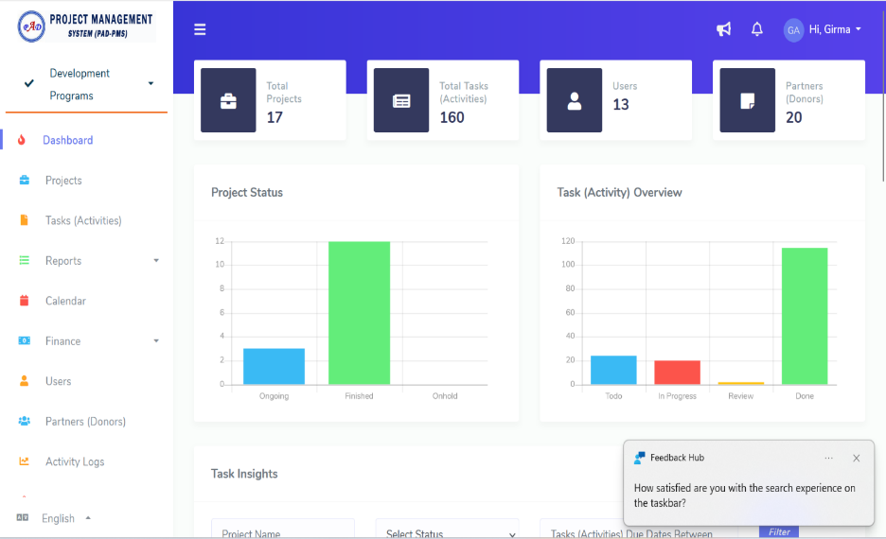
Organizational Systems
On line Program management system
Transparent Financial management systems
Updated Functional Policies

Slide 13
ACCOMPLISHMENTS – SUCCESS STORIES
Humanitarian
Achievement in CCCM program management in Amhara and Oromia
Able to provide assistance for IDPs in harsh condictiones including active war situation
Experience in construction of standard temporary communal shelter
Experience in provision of ESNFI & Cash
Active role in cluster and other platforms
Manage to directly reach to about 300,000 and above people affected by the war in North Ethiopian and Drought through

Slide 14
ACCOMPLISHMENTS – SUCCESS STORIES…Cont
Development
Center of excellence and knowledge hub on
Foster care and Local adoption – Used as input in developing Ethiopian Federal Government Foster care and Local Adoption Guidelines.
Livelihood and youth employment –Promotion and support of out of the box livelihood interventions Example. Compost production
Migrant Returnee Re-integration- providing psychological, social and economic re-integration.
Community based Mental Health Program - PAD’s Experience used in developing Ethiopian 2nd Mental Health Strategy.
Urban Destitute program Targeting street Children -PAD’s achievement used in developing national case management plan for urban destitute
Conflict early warning, conflict mitigation and Peace building -PAD contribution helped to conflict mitigation and peace building efforts in different part of the country including Eastern corridor of Ethiopia

Slide 15
Financial Management Capacity
PAD has an experience of managing an income with amount of 1,741,454 USD ETB during the last year alone. Its account is annually audited, and it has witnessed no audit gaps so far. PAD is strict in adhering to donor reporting requirements including timeliness, reporting formats and other compliance requirements.

Slide 16
Human Resource
Currently, PAD has 242 (119F) full time salaried staffs and including director, managers, advisors, project coordinators, project officers, social service workers, nurses, accountants, finance & HR officers and other administrative staffs.
At community level, the organization currently deployed about 650 part-time volunteers working as case workers in managing community level programs.
This means that PAD has strong grass-roots presence in the community which helps it to make a significant difference in the lives of most vulnerable and hard to reach community members.

Slide 17
The Strategic Advantage of Partnering with PAD
We provide high-quality services at a lower cost
Deeper grassroot presence
Extensive coverage and local knowledge
Expertise in managing development, emergency, and nexus programs
Transparency and accountability in program management:
Our moderate risk level in EHF-OCHA due diligence assessment: demonstrating commitment to compliance and quality service delivery
PAD’s government relations and commitment to quality service delivery
PAD’s proven track record and partnership INGOS and UN agencies
Our proven track record of successful program management
Our proved collaboration with private sector and universities
Our capacity in maximizing impact
Reaching the unreachable

Slide 18
LOOKING FORWARD
Increased engagements in Emergency responses
Enhanced focus on Disaster Risk management
Engaging in program that link Humanitarian Programming with Development agenda
Local empowerment – local expertise as strategic & sustained approach
Focus on Youth Women, Disability, Returnees, Refugees
Enhanced partnerships with academia, private sector
Continue to be a Center of Excellence and Knowledge hub in selected thematic areas

Slide 19
Thank you !
Spread Love and Humanity!!!

